Slide 1
DS&AI Project Knowledge Representation and Robotics
Marcello Bonsangue
LIACS – Leiden University
m.m.bonsangue@liacs.leidenuniv.nl

Slide 2
Outline
What is a robot
Action planning

Slide 3
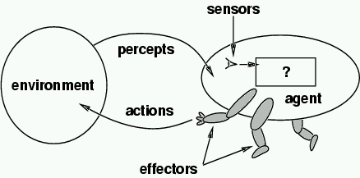
Autonomous Mobile Robots
Machines capable of moving about their environment and demonstrating some kind of intelligent behaviour
Permanent Perception-Cognition-Action cycle
Autonomy is the degree to which an agent's decisions are determined by its own observations and experience

Slide 4
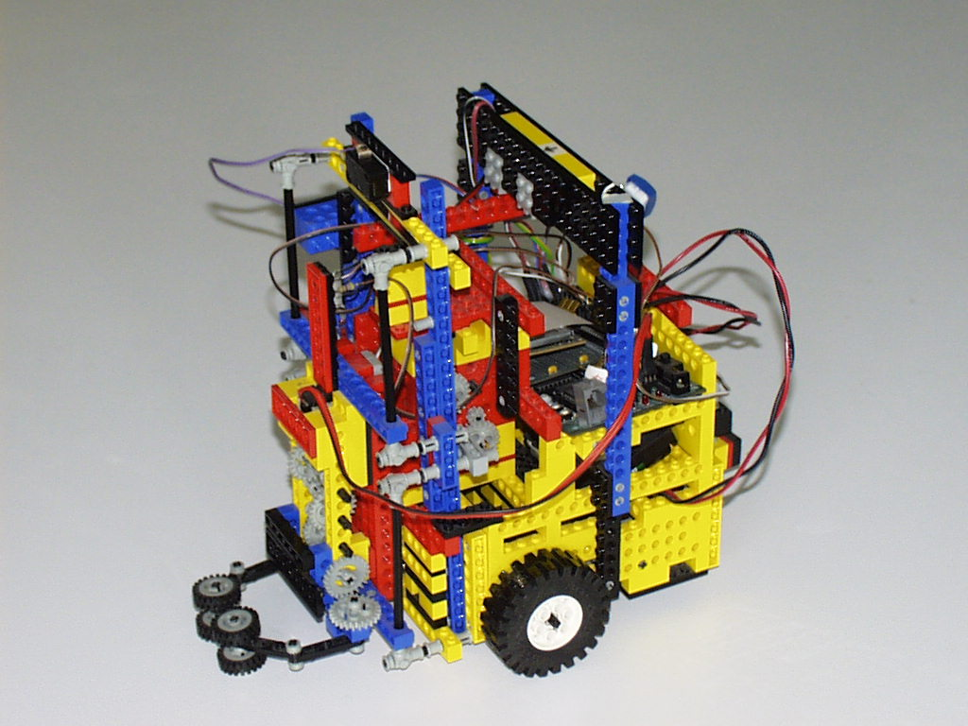
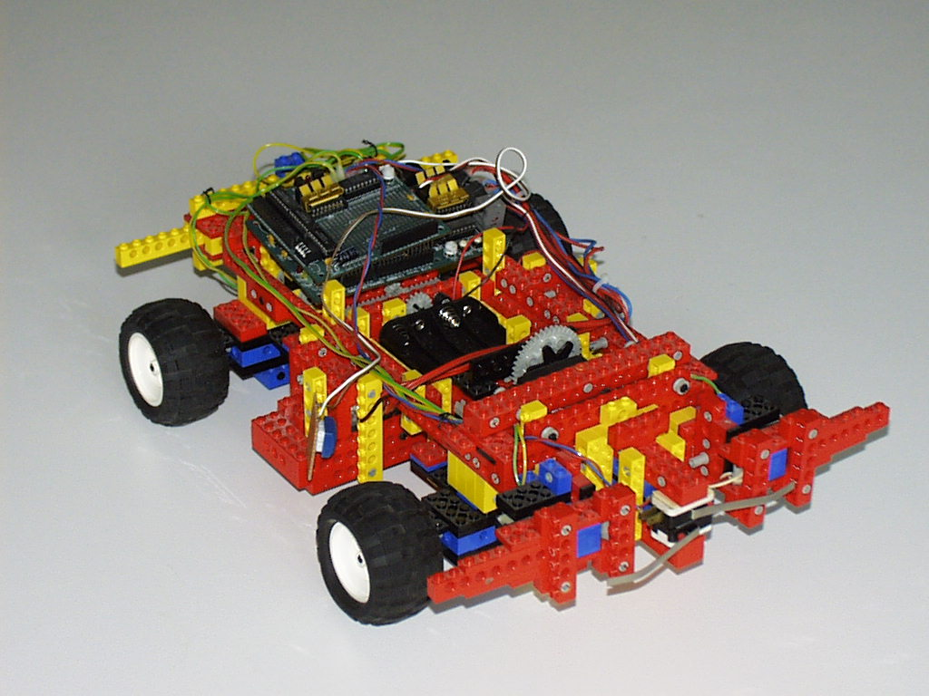
Example: LEGO-Bots

Slide 5
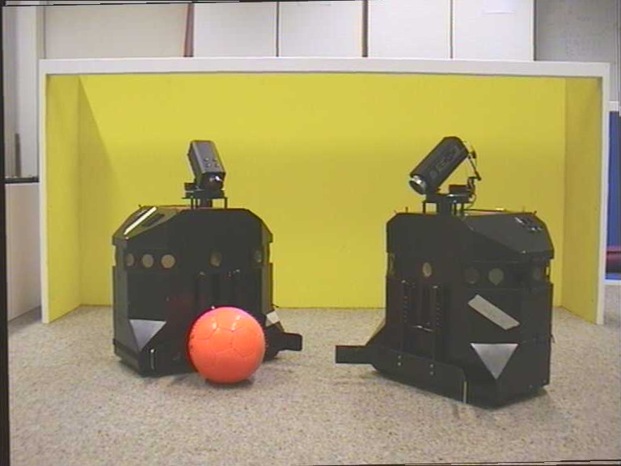
Example: Sparrows

Slide 6
Robot Anatomy
Effectors
mobile bases
manipulators (arms, hands, grippers, kickers)
other
Sensors
Electronics
Software
operating systems
programming languages
programming environments
programming methodology
Robot control architectures

Slide 7
Robotics Software Technology
State-of-the-art mobile robots use networked hardware
Software is distributed across available hardware
R-cam
Show me room H20!
stantalk
stanright
L-cam
PTU
laser
GUI
stanbook
stanleft
sonar
base

Slide 8
Robotics is AI-complete
Complex autonomous mobile robots must
represent various kinds of knowledge
knowledge representation
spatiotemporal representations
make inferences from knowledge and plan their action
inference; deduction, abduction
planning and scheduling
perceive their environment
sensor interpretation and sensor fusion
pattern recognition, computer vision
interact with humans
speech, natural language processing
adapt to changing environments and tasks
machine learning
neural network learning, reinforcement learning
evolutionary learning

Slide 9
Action planning
Where logic-based representation of knowledge makes search problems more interesting
The goal of action planning is to choose actions and ordering relations among these actions to achieve specified goals
Next, we develop a non-specific, logic-based language to represent knowledge about actions, states, and goals, and we will study how search algorithms can exploit this representation

Slide 10
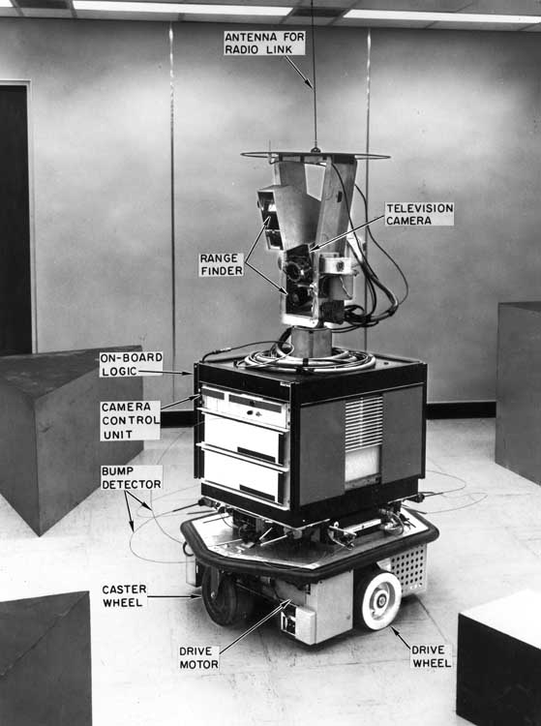
Knowledge Representation Tradeoff
Expressiveness vs. computational efficiency
STRIPS: a simple, still reasonably expressive planning language based on propositional logic
Examples of planning problems in STRIPS
Planning methods
Extensions of STRIPS
Like programming, knowledge representation is an art

Slide 11
The STRIPS Language through Examples

Slide 12

Vacuum-Robot Example
Two rooms: R₁ and R₂
A vacuum robot
Dust
R₁
R₂

Slide 13
State Representation
R₁
R₂
In(Robot, R₁) ∧ Clean(R₁)
Propositions that “hold” (i.e. are true)
in the state
Logical “and”
connective

Slide 14
State Representation
In(Robot, R₁) ∧ Clean(R₁)
R₁
R₂
Conjunction of propositions
No negated proposition, such as ¬Clean(R₂)
Closed-world assumption: Every proposition that is not listed in a state is false in that state
No “or” connective, such as In(Robot,R₁)∨In(Robot,R₂)
No variable, e.g., ∃x Clean(x)
No uncertainty

Slide 15
Goal Representation
Example: Clean(R₁) ∧ Clean(R₂)
Conjunction of propositions
No negated proposition
No “or” connective
No variable
A goal G is achieved in a state S if all the propositions in G (called sub-goals)
are also in S

Slide 16
Action Representation
Right
Precondition = In(Robot, R₁)
Delete-list = In(Robot, R₁)
Add-list = In(Robot, R₂)
In(Robot, R₁) ∧ Clean(R₁)
R₁
R₂
R₁
R₂
Right
In(Robot, R₂) ∧ Clean(R₁)

Slide 17
Action Representation
Right
Precondition = In(Robot, R₁)
Delete-list = In(Robot, R₁)
Add-list = In(Robot, R₂)
Sets of propositions
Same form as a goal: conjunction of propositions

Slide 18
Action Representation
An action A is applicable to a state S if the propositions in its precondition are all in S
The application of A to S is a new state obtained by deleting the propositions in the delete list from S and adding those in the add list
Right
Precondition = In(Robot, R₁)
Delete-list = In(Robot, R₁)
Add-list = In(Robot, R₂)

Slide 19
Other Actions
Left
P = In(Robot, R₂)
D = In(Robot, R₂)
A = In(Robot, R₁)
Suck(R₁)
P = In(Robot, R₁)
D = ∅ [empty set]
A = Clean(R₁)
Suck(R₂)
P = In(Robot, R₂)
D = ∅ [empty set]
A = Clean(R₂)

Slide 20
Action Schema
It describes several actions, here: Suck(R₁) and Suck(R₂)
Left
P = In(Robot, R₂)
D = In(Robot, R₂)
A = In(Robot, R₁)
Suck(r)
P = In(Robot, r)
D = ∅
A = Clean(r)
Parameter that will get “instantiated” by
matching the precondition against a state

Slide 21
Action Schema
R₁
R₂
R₁
R₂
Left
P = In(Robot, R₂)
D = In(Robot, R₂)
A = In(Robot, R₁)
Suck(r)
P = In(Robot, r)
D = ∅
A = Clean(r)
Suck(R₂)
In(Robot, R₂) ∧ Clean(R₁)
In(Robot, R₂) ∧ Clean(R₁)
∧ Clean(R₂)
r ← R₂

Slide 22
Action Schema
R₁
R₂
R₁
R₂
Left
P = In(Robot, R₂)
D = In(Robot, R₂)
A = In(Robot, R₁)
Suck(r)
P = In(Robot, r)
D = ∅
A = Clean(r)
Suck(R₁)
In(Robot, R₁) ∧ Clean(R₁)
In(Robot, R₁) ∧ Clean(R₁)
r ← R₁

Slide 23
Blocks-World Example
A robot hand can move blocks on a table
The hand cannot hold more than one block at a time
No two blocks can fit directly on the same block
The table is arbitrarily large
C
A
B
TABLE

Slide 24
State
Block(A) ∧ Block(B) ∧ Block(C) ∧
On(A,TABLE) ∧ On(B,TABLE) ∧
On(C,A) ∧
Clear(B) ∧ Clear(C) ∧
Handempty
C
A
B
TABLE

Slide 25
Goal
C
B
A
On(A,TABLE) ∧ On(B,A) ∧ On(C,B) ∧ Clear(C)

Slide 26
Goal
C
B
A
On(A,TABLE) ∧ On(B,A) ∧ On(C,B) ∧ Clear(C)

Slide 27
Goal
C
C
B
A
B
A
On(A,TABLE) ∧ On(C,B)

Slide 28
Action
Unstack(x,y)
P = Handempty∧ Block(x) ∧ Block(y) ∧ Clear(x) ∧ On(x,y)
D = Handempty, Clear(x), On(x,y)
A = Holding(x), Clear(y)

Slide 29
Action
Unstack(x,y)
P = Handempty∧ Block(x) ∧ Block(y) ∧ Clear(x) ∧ On(x,y)
D = Handempty, Clear(x), On(x,y)
A = Holding(x), Clear(y)
Block(A) ∧ Block(B) ∧ Block(C) ∧ On(A,TABLE) ∧ On(B,TABLE) ∧ On(C,A) ∧ Clear(B) ∧ Clear(C) ∧ Handempty
C
A
B
Unstack(C,A)
P = Handempty∧ Block(C) ∧ Block(A) ∧ Clear(C) ∧ On(C,A)
D = Handempty, Clear(C), On(C,A)
A = Holding(C), Clear(A)

Slide 30
Action
Unstack(x,y)
P = Handempty∧ Block(x) ∧ Block(y) ∧ Clear(x) ∧ On(x,y)
D = Handempty, Clear(x), On(x,y)
A = Holding(x), Clear(y)
C
Block(A) ∧ Block(B) ∧ Block(C) ∧ On(A,TABLE) ∧ On(B,TABLE) ∧ On(C,A) ∧ Clear(B) ∧ Clear(C) ∧ Handempty
∧ Holding(C) ∧ Clear(A)
C
A
B
Unstack(C,A)
P = Handempty∧ Block(C) ∧ Block(A) ∧ Clear(C) ∧ On(C,A)
D = Handempty, Clear(C), On(C,A)
A = Holding(C), Clear(A)

Slide 31
Action
Unstack(x,y)
P = Handempty∧ Block(x) ∧ Block(y) ∧ Clear(x) ∧ On(x,y)
D = Handempty, Clear(x), On(x,y)
A = Holding(x), Clear(y)
C
Block(A) ∧ Block(B) ∧ Block(C) ∧ On(A,TABLE) ∧ On(B,TABLE) ∧ On(C,A) ∧ Clear(B) ∧ Clear(C) ∧ Handempty
∧ Holding(C) ∧ Clear(A)
A
B
Unstack(C,A)
P = Handempty∧ Block(C) ∧ Block(A) ∧ Clear(C) ∧ On(C,A)
D = Handempty, Clear(C), On(C,A)
A = Holding(C), Clear(A)

Slide 32
All Actions
Unstack(x,y)
P = Handempty ∧ Block(x) ∧ Block(y) ∧ Clear(x) ∧ On(x,y)
D = Handempty, Clear(x), On(x,y)
A = Holding(x), Clear(y)
Stack(x,y)
P = Holding(x) ∧ Block(x) ∧ Block(y) ∧ Clear(y)
D = Clear(y), Holding(x)
A = On(x,y), Clear(x), Handempty
Pickup(x)
P = Handempty ∧ Block(x) ∧ Clear(x) ∧ On(x,Table)
D = Handempty, Clear(x), On(x,Table)
A = Holding(x)
Putdown(x)
P = Holding(x), ∧ Block(x)
D = Holding(x)
A = On(x,Table), Clear(x), Handempty

Slide 33
All Actions
Unstack(x,y)
P = Handempty ∧ Block(x) ∧ Block(y) ∧ Clear(x) ∧ On(x,y)
D = Handempty, Clear(x), On(x,y)
A = Holding(x), Clear(y)
Stack(x,y)
P = Holding(x) ∧ Block(x) ∧ Block(y) ∧ Clear(y)
D = Clear(y), Holding(x),
A = On(x,y), Clear(x), Handempty
Pickup(x)
P = Handempty ∧ Block(x) ∧ Clear(x) ∧ On(x,Table)
D = Handempty, Clear(x), On(x,TABLE)
A = Holding(x)
Putdown(x)
P = Holding(x), ∧ Block(x)
D = Holding(x)
A = On(x,TABLE), Clear(x), Handempty
A block can always fit
on the table

Slide 34


Key-in-Box Example
The robot must lock the door and put the key in the box
The key is needed to lock and unlock the door
Once the key is in the box, the robot can’t get it back
R₁
R₂

Slide 35
Initial State
In(Robot,R₂) ∧ In(Key,R₂) ∧ Unlocked(Door)
R₁
R₂

Slide 36
Goal
Locked(Door) ∧ In(Key,Box)
[The robot’s location isn’t specified in the goal]
R₁
R₂

Slide 37
Actions
Grasp-Key-in-R₂
P = In(Robot,R₂) ∧ In(Key,R₂)
D = ∅
A = Holding(Key)
Lock-Door
P = Holding(Key)
D = ∅
A = Locked(Door)
Move-Key-from-R₂-into-R₁
P = In(Robot,R₂) ∧ Holding(Key) ∧ Unlocked(Door)
D = In(Robot,R₂), In(Key,R₂)
A = In(Robot,R₁), In(Key,R₁)
Put-Key-Into-Box
P = In(Robot,R₁) ∧ Holding(Key)
D = Holding(Key), In(Key,R₁)
A = In(Key,Box)
R₁
R₂

Slide 38
Planning Methods

Slide 39
Forward Planning
Suck(R₁)
R₁
R₂
R₁
R₂
Right
Left
Initial state
Suck(R₂)
Goal: Clean(R₁) ∧ Clean(R₂)
R₁
R₂

Slide 40
Forward Planning
Goal: On(B,A) ∧ On(C,B)
Pickup(B)
B
C
C
C
B
A
B
A
A
Unstack(C,A))
C
C
C
B
A
B
A
B
A
B
B
A
B
C
A
C
A
C

Slide 41
Need for an Accurate Heuristic
Forward planning simply searches the space of world states from the initial to the goal state
Imagine an agent with a large library of actions, whose goal is G, e.g., G = Have(Milk)
In general, many actions are applicable to any given state, so the branching factor is huge
In any given state, most applicable actions are irrelevant to reaching the goal Have(Milk)
Fortunately, an accurate consistent heuristic can be computed using planning graphs

Slide 42
Planning Graph for a State of the Vacuum Robot
S₀ contains the state’s propositions (here, the initial state)
A₀ contains all actions whose preconditions appear in S₀
S₁ contains all propositions that were in S₀ or are contained in the add lists of the actions in A₀
So, S₁ contains all propositions that may be true in the state reached after the first action
A₁ contains all actions not already in A₀ whose preconditions appear in S₁, hence that may be executable in the state reached after executing the first action. Etc...
S₀
A₀
S₁
A₁
S₂
In(Robot,R₁)
Clean(R₁)
In(Robot,R₁)
Clean(R₁)
In(Robot,R₂)
In(Robot,R₁)
Clean(R₁)
In(Robot,R₂)
Clean(R₂)
R₁
R₂
persistence
actions
Right
Suck(R₁)
Left
Suck(R₂)

Slide 43
Planning Graph for a State of the Vacuum Robot
The smallest value of i such that S_{i} contains all the goal propositions is called the level cost of the goal (here i=2)
By construction of the planning graph, it is a lower bound on the number of actions needed to reach the goal
In this case, 2 is the actual length of the shortest path to the goal
S₀
A₀
S₁
A₁
S₂
In(Robot,R₁)
Clean(R₁)
In(Robot,R₁)
Clean(R₁)
In(Robot,R₂)
In(Robot,R₁)
Clean(R₁)
In(Robot,R₂)
Clean(R₂)
R₁
R₂
Right
Suck(R₁)
Left
Suck(R₂)

Slide 44
Planning Graph for Another State
The level cost of the goal is 1, which again is the actual length of the shortest path to the goal
S₀
A₀
S₁
In(Robot,R₂)
Clean(R₁)
In(Robot,R₂)
Clean(R₁)
In(Robot,R₁)
Clean(R₂)
R₁
R₂
Left
Suck(R₂)

Slide 45
Application of Planning Graphs to Forward Planning
Whenever a new node is generated, compute the planning graph of its state [update the planning graph at the parent node]
Stop computing the planning graph when:
Either the goal propositions are in a set S_{i}
[then i is the level cost of the goal]
Or when S_{i+1} = S_{i} (the planning graph has leveled off) [then the generated node is not on a solution path]
Set the heuristic h(N) of a node N to the level cost of the goal for the state of N
h is a consistent heuristic for unit-cost actions
Hence, A* using h yields a solution with minimum number of actions

Slide 46
Size of Planning Graph
An action appears at most once
A proposition is added at most once and each S_{k} (k ≠ i) is a strict superset of S_{k-1}
So, the number of levels is bounded by Min{number of actions, number of propositions}
In contrast, the state space can be exponential in the number of propositions (why?)
The computation of the planning graph may save a lot of unnecessary search work
S₀
A₀
S₁
A₁
S₂
In(Robot,R₁)
Clean(R₁)
In(Robot,R₁)
Clean(R₁)
In(Robot,R₂)
In(Robot,R₁)
Clean(R₁)
In(Robot,R₂)
Clean(R₂)
Right
Suck(R₁)
Left
Suck(R₂)

Slide 47
Improvement of Planning Graph: Mutual Exclusions
Goal: Refine the level cost of the goal to be a more accurate estimate of the number of actions needed to reach it
Method: Detect obvious exclusions among propositions at the same level (see R&N)
It usually leads to more accurate heuristics, but the planning graphs can be bigger and more expensive to compute

Slide 48
Forward planning still suffers from an excessive branching factor
In general, there are much fewer actions that are relevant to achieving a goal than actions that are applicable to a state
How to determine which actions are relevant? How to use them?
→ Backward planning

Slide 49
Goal-Relevant Action
An action is relevant to achieving a goal if a proposition in its add list matches a sub-goal proposition
For example:
Stack(B,A) P = Holding(B) ∧ Block(B) ∧ Block(A) ∧ Clear(A) D = Clear(A), Holding(B),
A = On(B,A), Clear(B), Handempty
is relevant to achieving On(B,A)∧On(C,B)

Slide 50
Regression of a Goal
The regression of a goal G through an
action A is the least constraining
precondition R[G,A] such that:
If a state S satisfies R[G,A] then:
The precondition of A is satisfied in S
Applying A to S yields a state that satisfies G

Slide 51
Example
G = On(B,A) ∧ On(C,B)
Stack(C,B)
P = Holding(C) ∧ Block(C) ∧ Block(B) ∧ Clear(B)
D = Clear(B), Holding(C)
A = On(C,B), Clear(C), Handempty
R[G,Stack(C,B)] = On(B,A) ∧ Holding(C) ∧ Block(C) ∧ Block(B) ∧ Clear(B)

Slide 52
Example
G = On(B,A) ∧ On(C,B)
Stack(C,B)
P = Holding(C) ∧ Block(C) ∧ Block(B) ∧ Clear(B)
D = Clear(B), Holding(C)
A = On(C,B), Clear(C), Handempty
R[G,Stack(C,B)] = On(B,A) ∧ Holding(C) ∧ Block(C) ∧ Block(B) ∧ Clear(B)

Slide 53
Another Example
G = In(key,Box) ∧ Holding(Key)
Put-Key-Into-Box
P = In(Robot,R₁) ∧ Holding(Key)
D = Holding(Key), In(Key,R₁)
A = In(Key,Box)
R[G,Put-Key-Into-Box] = ??
R₁
R₂

Slide 54
Another Example
G = In(key,Box) ∧ Holding(Key)
Put-Key-Into-Box
P = In(Robot,R₁) ∧ Holding(Key)
D = Holding(Key), In(Key,R₁)
A = In(Key,Box)
R[G,Put-Key-Into-Box] = False where False is the un-achievable goal
This means that In(key,Box) ∧ Holding(Key) can’t be achieved by executing Put-Key-Into-Box
R₁
R₂

Slide 55
Computation of R[G,A]
If any sub-goal of G is in A’s delete list then return False
Else
G’ ← Precondition of A
For every sub-goal SG of G do
If SG is not in A’s add list then add SG to G’
Return G’

Slide 56
Backward Planning
On(B,A) ∧ On(C,B)
C
A
B
Initial state

Slide 57
Backward Planning
C
On(B,A) ∧ On(C,B)
A
B
Stack(C,B)
Initial state
On(B,A) ∧ Holding(C) ∧ Clear(B)
Pickup(C)
On(B,A) ∧ Clear(B) ∧ Handempty ∧ Clear(C) ∧ On(C,Table)
Stack(B,A)
Clear(C) ∧ On(C,TABLE) ∧ Holding(B) ∧ Clear(A)
Pickup(B)
Clear(C) ∧ On(C,Table) ∧ Clear(A) ∧ Handempty ∧ Clear(B) ∧ On(B,Table)
Putdown(C)
Clear(A) ∧ Clear(B) ∧ On(B,Table) ∧ Holding(C)
Unstack(C,A)
Clear(B) ∧ On(B,Table) ∧ Clear(C) ∧ Handempty ∧ On(C,A)

Slide 58
Backward Planning
On(B,A) ∧ On(C,B)
Stack(C,B)
C
On(B,A) ∧ Holding(C) ∧ Clear(B)
A
B
Initial state
Pickup(C)
On(B,A) ∧ Clear(B) ∧ Handempty ∧ Clear(C) ∧ On(C,Table)
Stack(B,A)
Clear(C) ∧ On(C,TABLE) ∧ Holding(B) ∧ Clear(A)
Pickup(B)
Clear(C) ∧ On(C,Table) ∧ Clear(A) ∧ Handempty ∧ Clear(B) ∧ On(B,Table)
Putdown(C)
Clear(A) ∧ Clear(B) ∧ On(B,Table) ∧ Holding(C)
Unstack(C,A)
Clear(B) ∧ On(B,Table) ∧ Clear(C) ∧ Handempty ∧ On(C,A)

Slide 59
Search Tree
Backward planning searches a space of goals from the original goal of the problem to a goal that is satisfied in the initial state
There are often much fewer actions relevant to a goal than there are actions applicable to a state → smaller branching factor than in forward planning
The lengths of the solution paths are the same

Slide 60
Consistent Heuristic for Backward Planning
A consistent heuristic is obtained as follows :
Pre-compute the planning graph of the initial state until it levels off
For each node N added to the search tree, set h(N) to the level cost of the goal associated with N
If the goal associated with N can’t be satisfied in any set S_{k} of the planning graph, it can’t be achieved, so prune it!
A single planning graph is computed

Slide 61
How Does Backward Planning Detect Dead-Ends?
On(B,A) ∧ On(C,B)
Stack(C,B)

Slide 62
How Does Backward Planning Detect Dead-Ends?
On(B,A) ∧ On(C,B)
Stack(B,A)
Holding(B) ∧ Clear(A) ∧ On(C,B)
Stack(C,B)
Holding(B) ∧ Clear(A) ∧ Holding(C) ∧ Clear (B)
Pick(B) [delete list contains Clear(B)]
False

Slide 63
How Does Backward Planning Detect Dead-Ends?
On(B,A) ∧ On(C,B)
Stack(B,A)
Holding(B) ∧ Clear(A) ∧ On(C,B)
A state constraint such as
Holding(x) → ¬(∃y)On(y,x) would have made it possible to prune the path earlier

Slide 64
Same way works with more complex KR languages than STRIPS

